Slide 1
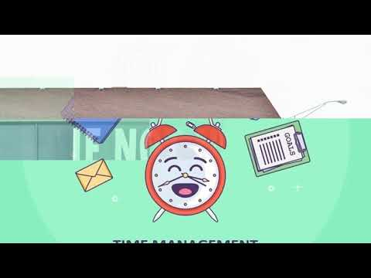
5 Weeks of Wellness: Time Management

Slide 2
Resources
Planners
https://www.iheartplanners.com/how-to-color-code-your-planner/
Tips for focusing during Online learning
https://www.dailycal.org/2020/03/17/cyber-focused-how-to-do-well-in-your-now-online-classes/

Slide 3
Resources

Slide 4
Resources
Worksheets
Homework to do sheet
Homework to do sheet
Time Management worksheet

