Slide 1
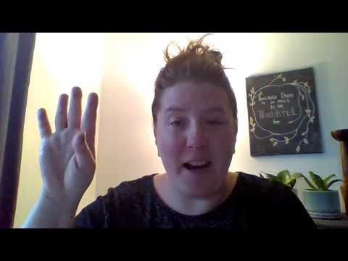
Anxiety
5 Weeks of Wellness:Skyhawks Strong

Slide 2
Survey
Beginning Survey link

Slide 3
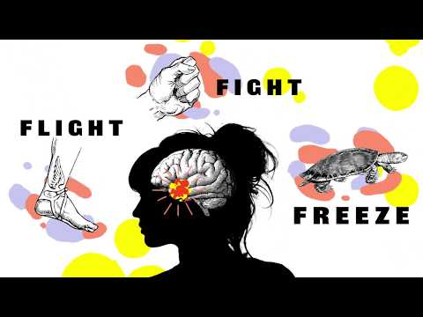
What is Anxiety?

Slide 4
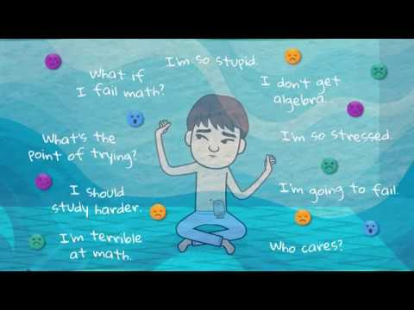
You are more than just your anxious thoughts.

Slide 5
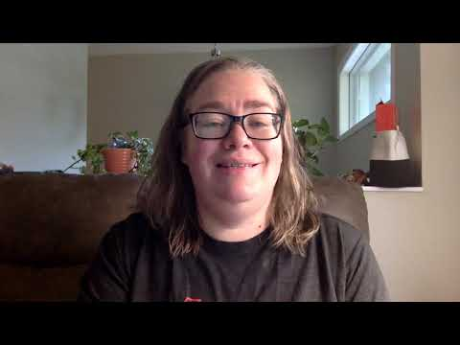
What do I do now?

Slide 6
Raffle entry ticket
Raffle ticket link
Don’t forget to complete this with EVERYTHING you do! If you watched the video, if you look at the apps or worksheets below. Each time you complete it you get a raffle entry!

Slide 7
Resources
Washington County Crisis Line
503-291-9111
Hawthorn Walk-In Center: drop in mental health support
503-846-4555
YouthLine
877-968-8491
National suicide prevention lifeline
1-800-273-TALK (8255)
Crisis Text Line
Text “Listen” to 741741

Slide 8
Resources
Podcasts
https://podcasts.apple.com/us/podcast/epispde-1-how-to-deal-stress-anxiety-in-stressful-anxious/id1518620024?i=1000478037585
APPS
The Shine app: https://www.theshineapp.com/
Mindshift: https://www.anxietycanada.com/resources/mindshift-cbt/
Calm: https://www.calm.com/
MyStrength: https://mystrength.com/

Slide 9
Resources
Books
Non-Fiction
Anxiety Sucks! By Natasha Daniels
Stress 101 By Margaret O. Hyde & Elizabeth H. Forsyth
Fiction
Turtles all the way Down By John Green
The Upside of Unrequited by Becky Albertalli
Websites
https://www.anxietycanada.com/
Worksheets
Throw Anxiety in the Trash!
Flipping Stress

