Slide 1
Stress Management
Don’t forget to fill out a survey and exit ticket.

Slide 2
Resources
Websites
https://parentandteen.com/teen-stress-management-plan/
https://www.thepathway2success.com/virtual-calm-down-activities/
https://magoosh.com/hs/gen/2020/15-tips-student-stress-covid-19/
https://www.naminh.org/resources-2/bipoc/
APPS
https://www.calm.com/

Slide 3
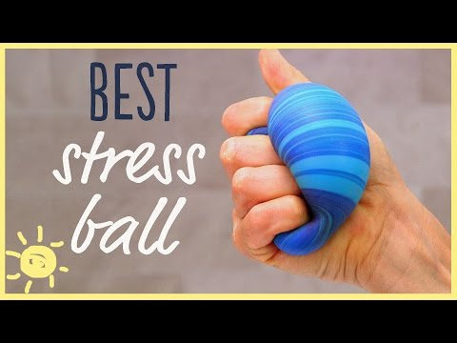
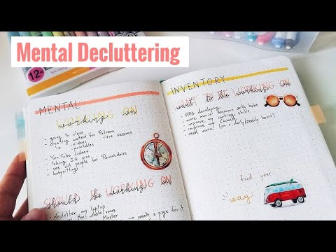
Video resources

Slide 4
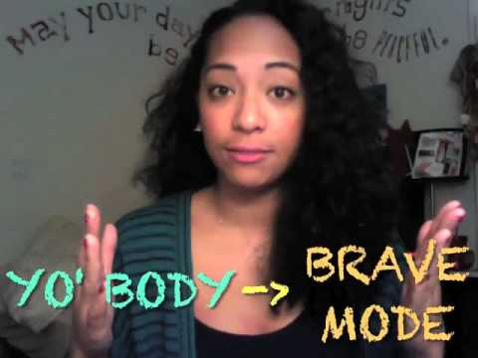

Slide 5
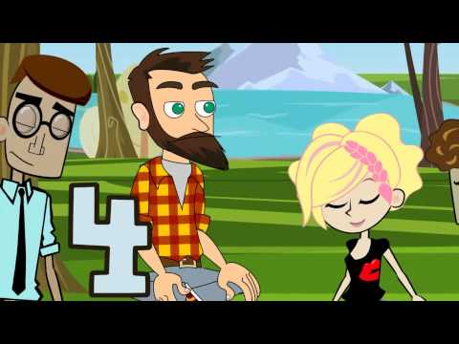
Breathing and Exercise

Slide 6
Get better sleep
https://drcraigcanapari.com/eight-teen-sleep-tips/

