Slide 1
Goal Setting Resources

Slide 2
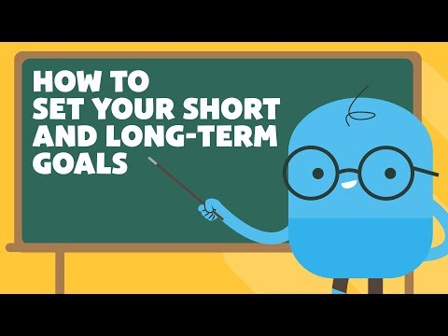

Slide 3
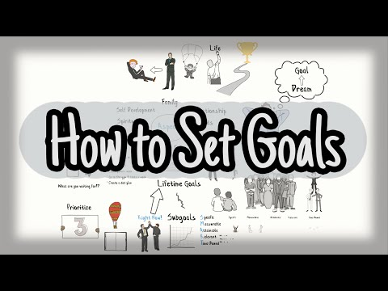

Slide 4
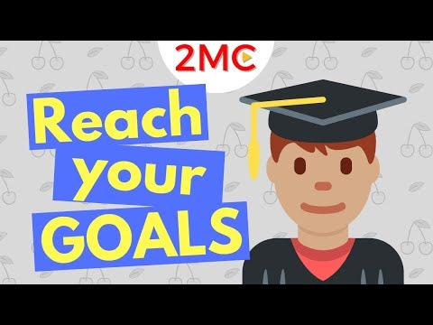

Slide 6
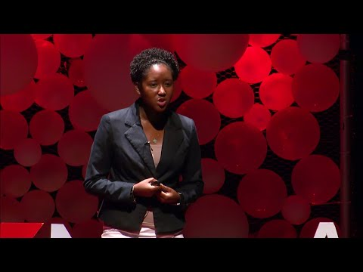

Slide 7
Make a Vision Board to help with Goals
Vision boards are a great way to plan out your goals, especially the big ones that are especially meaningful to you. Helping your children or students create a vision board will challenge them, get them thinking about what is most important to them, and encourage them to stay motivated in striving towards their goals.
Here’s how to create an effective vision board:
Gather some old magazines (you can also draw pictures, use newspapers, print out some pictures, etc.) and have your students cut out some pictures that represent their hopes and dreams for the future.
Help your students arrange the pictures on a piece of cardboard and use glue to secure them in place. You can also provide glitter, stickers, ribbons, markers, and anything else they might like to decorate their vision board with.
Ask your students to describe what each picture represents and how he or she plans to work toward that goal. If your class is too large or you have some shy students, ask them to write it down instead of sharing it out to the group.
Send them home with their vision board or hang it somewhere in the classroom if there’s space for all of them.

Slide 8
Websites
https://biglifejournal.com/blogs/blog/guide-effective-goal-setting-teens-template-worksheet
https://powerfulyouth.com/beginners-guide-goal-setting-for-teens-smart-go
https://www.teensmartgoals.com/goal-setting-for-teens
https://7mindsets.com/smart-goal-setting-for-students/

Slide 9
Podcasts
Worksheets
The Project Life Mastery Podcast
Simple Goal Setting worksheet

Slide 10
CREDITS
This is where you give credit to the ones who are part of this project.
Did you like the resources on this template? Get them for free at our other websites.
Presentation template by Slidesgo
Icons by Flaticon
Infographics by Freepik
Author introduction slide photo created by Freepik
Text & Image slide photo created by Freepik.com

